Slide 1

BUAN 6356.003 project R code

Slide 2
Default of Credit Card Clients Data Set
INTRODUCTION: This research is aimed at the case of customers default payments in Taiwan and compares the predictive accuracy of probability of default among six data mining methods.
STEPS USED :
Data Source
UCI Machine Learning Repository default of credit card clients Data set
https://archive.ics.uci.edu/ml/datasets/default+of+credit+card+clients
Supervised learning techniques were used for this project since the output is classification/logical type.
MODELS
1. KNN Classification
2. Logistic Regression
3. Naive Bayes Classifier
Training, Testing and Evaluation
Data modeling
Exploratory Data Analysis

Slide 3
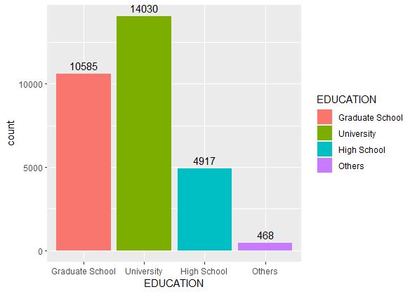
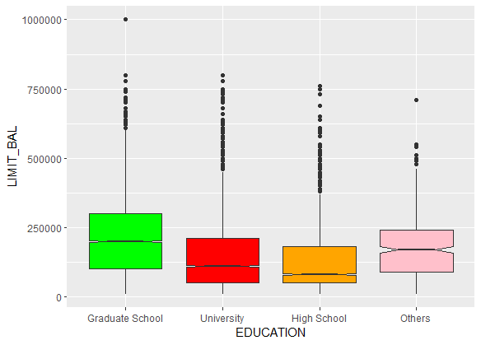
Number of Customers Grouped by Education
The dataset has most of the people with Graduate school and University background.
Education
Limit Balance of Customers by Education
It is evident that customers with graduate degrees have higher maximum balances.

Slide 4
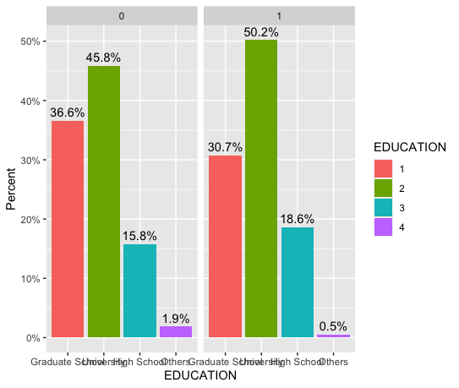
Analysing Customer’s
Education vs Default
University graduates make up 50.2% of those who default on loans, compared to 45.8% of those who don't. Only the percentage of students in high school increased between the No default and default categories.

Slide 5
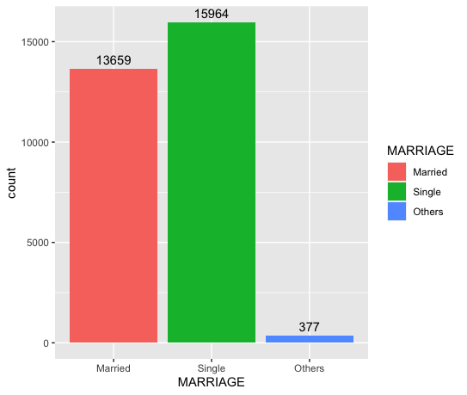
Analysing Customer Based on Marriage
The dataset has more single individuals than married individuals combined.

Slide 6
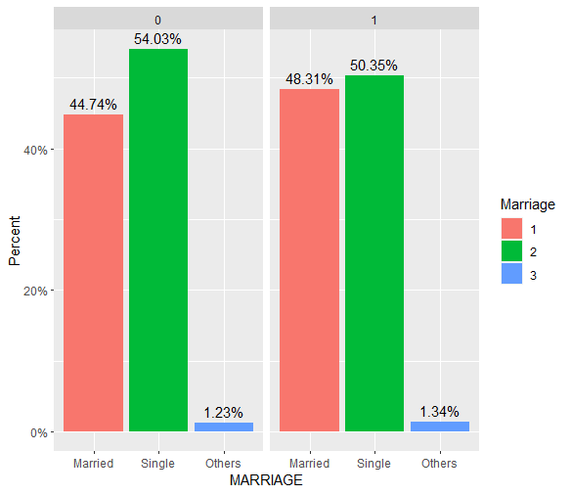
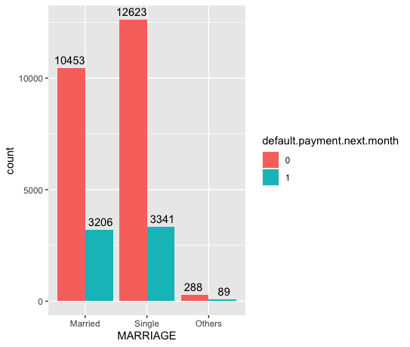
Analysing customer’s Marriage vs Default
Percentage of single people who doesn’t default on loan is higher than married and others combined.
The dataset has highest number of people from (singles who doesn’t default on loan category)

Slide 7
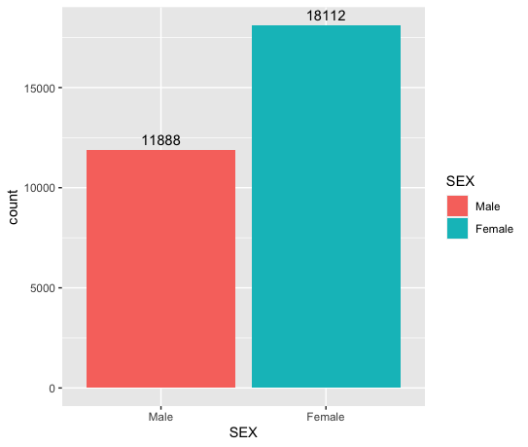
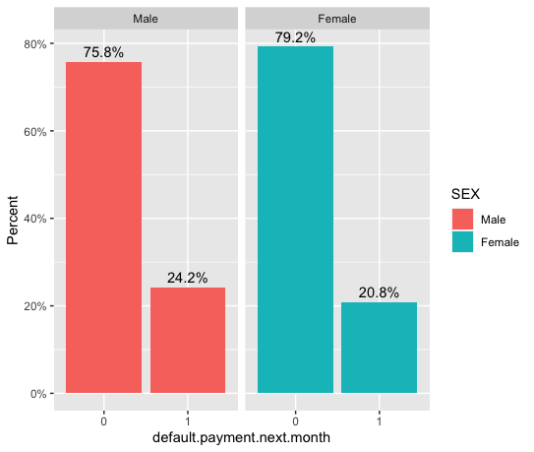
Group by Sex(M/F)
The dataset has 53% more females than males.
Sex vs Default
24.2% males defaults on loan. 20.8% females defaults on loan.

Slide 8
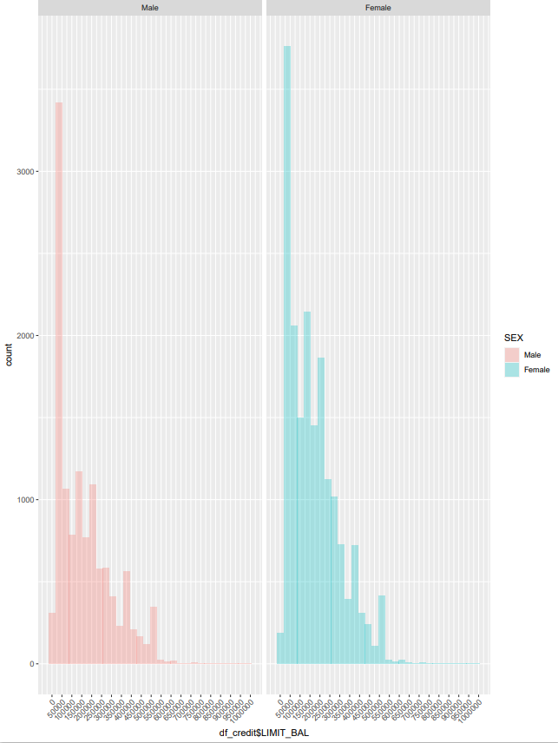
Sex vs Limit Balance
The male and female histograms are presented, and it is clear that the limit- bal 0-5000 interval has a larger count of both gender than other intervals.

Slide 9
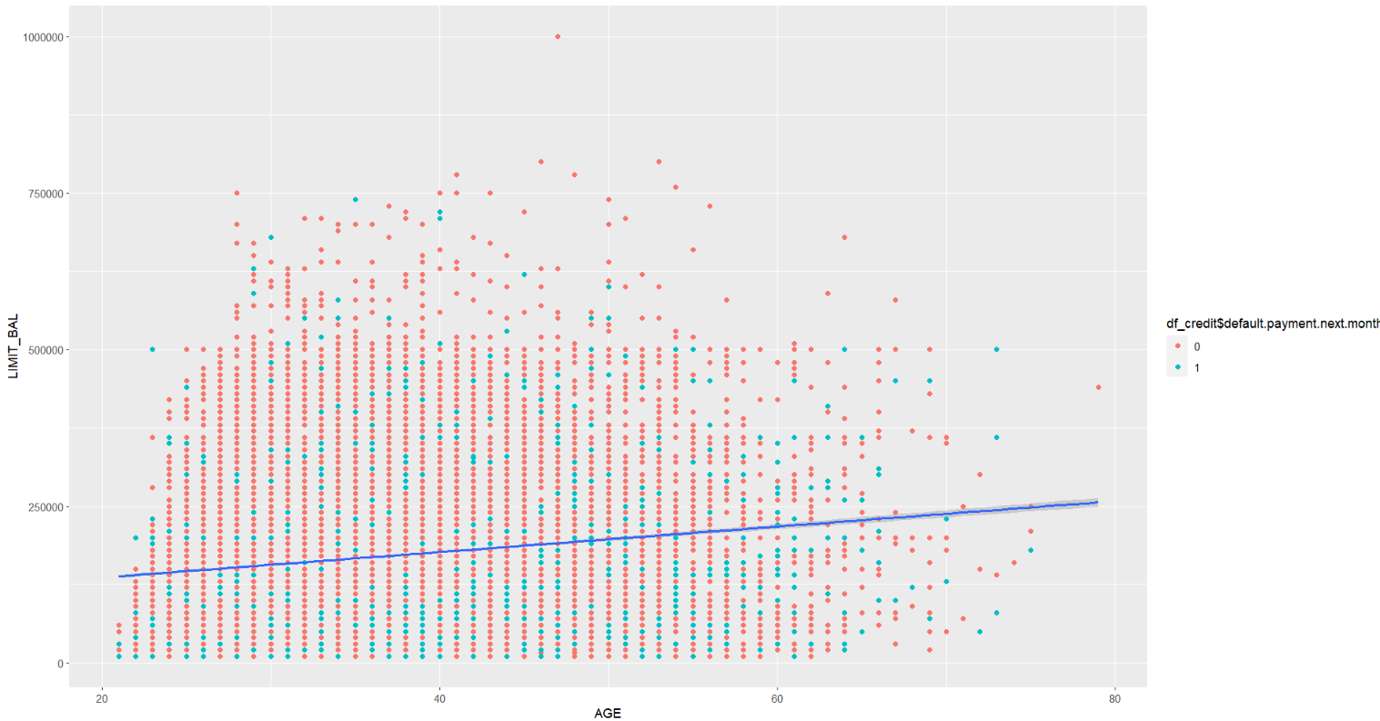
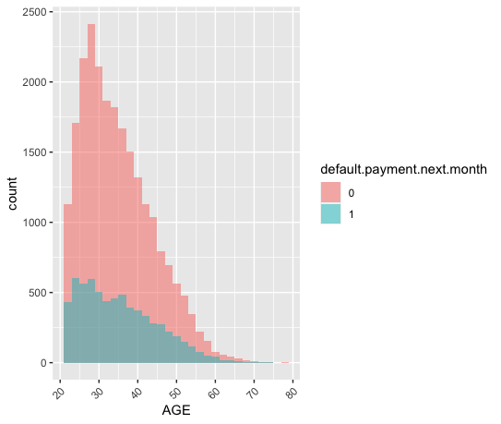
Age vs Limit Balance
The scatter plot has points with two categories randomly split throughout the graph.
AGE
Age vs Default
Here the default payments next month in the data set are represented by binary variables 0 and 1 where the payments made are shown as 0 and default payments are shown as 1.
Between the ages of 20 and 30, we can see more than 500 default payments.
The maximum number of payments were made by more than 2000 persons who were in the age between 25 to 30
The Histogram of payments made is higher than the default payments.

Slide 10

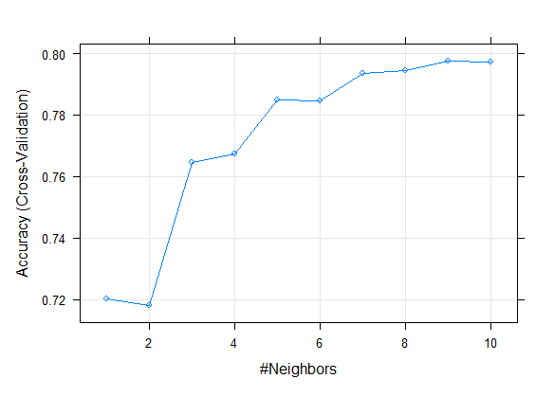
KNN Fit
KNN, is a supervised learning classifier, which uses proximity to make classifications or predictions about the grouping of an individual data point. While it can be used for either regression or classification problems, it is typically used as a classification algorithm, working off the assumption that similar points can be found near one another.
Plot of neighbors(K) vs. accuracy for each number is plotted. We can see that accuracy increases as the neighbors increase until 9 neighbors. After 9 the accuracy decreased for 10 neighbors. So the optimal neighbors(K) is 9.

Slide 11

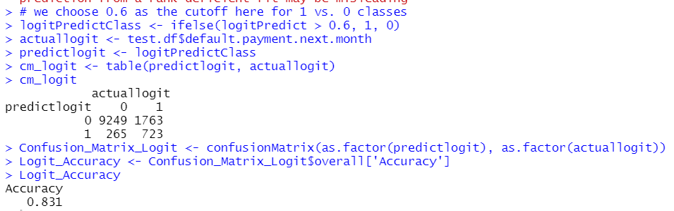
Logistic regression
Logistic regression predicts the output of a categorical dependent variable. Therefore, the outcome must be a categorical or discrete value. It can be either Yes or No, 0 or 1, true or False, etc.
Accuracy for the logistic regression is 83.1%.

Slide 12

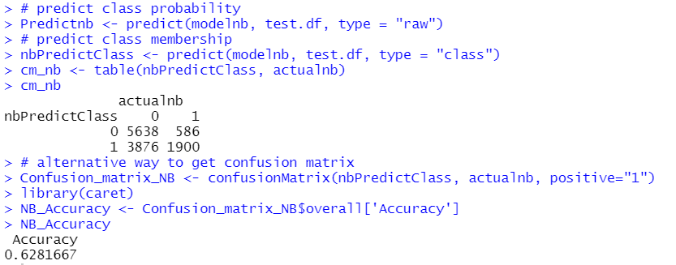
Navie Bayes
Naive Bayes is classification approach that adopts the principle of class conditional independence from the Bayes Theorem. This means that the presence of one feature does not impact the presence of another in the probability of a given outcome, and each predictor has an equal effect on that result.
The accuracy for the Naive Bayes model is 62.81 % which is less than we got from logistic regression(83.1%)

Slide 13
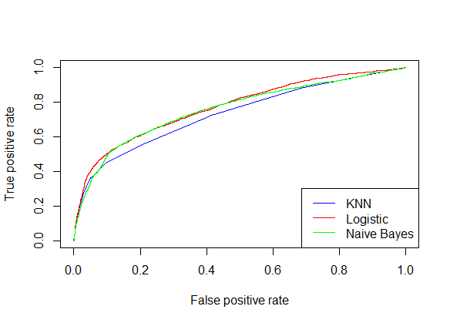
Comparision of ROC for different models
ROC curves typically feature true positive rate on the Y axis, and false positive rate on the X axis. This is not very realistic, but it does mean that a larger area under the curve (AUC) is usually better. ROC curves showing the association of different models (KNN, Logistic, Naïve Bayes)
Notes:
Receiver operatic characteristic curve, at all classification threshold.

Slide 14
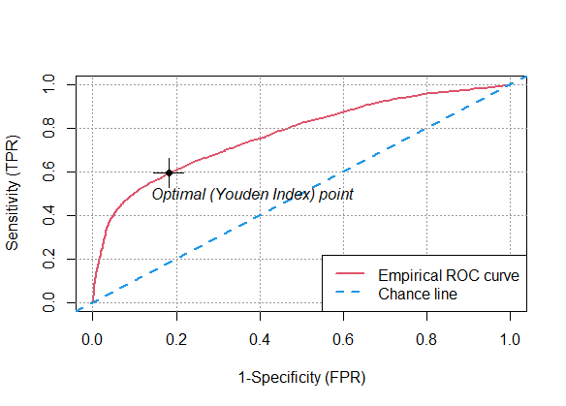
Plot ROC
A Youden Plot is a scatter plot representation of results obtained from N laboratories on two similar materials sensitivity(TPR) and specificity(FPR). The main objective of the plot is to find out which of the N labs gave unreliable or faulty results.
This is the best Empirical ROC curve, this has optimal point at 0.6 .

Slide 15
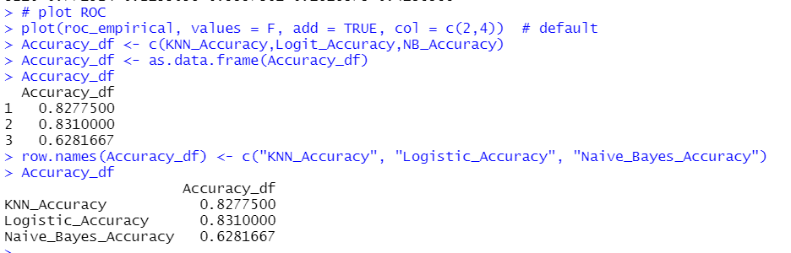
ACCURACY
From the above results we can see that the logistic regression model yielded that high accuracy of 83.1% so we choose logistic regression technique to build a model for to classify customers as default or No default

Slide 16
THANK YOU

